Slide 2

Sermon on the Mount
Matthew 5-7
“No Man Can Serve Two Masters”
Matthew 6:24

Slide 3
Sermon
on
the Mount
Direction In Life Is So Important
Matthew 6:19-21
“Do not lay up for yourselves treasures on earth…”
“lay up for yourselves treasures in heaven…”
  V. 24 “No one can serve two masters; for either he will hate the one and love the other, or else he will be loyal to the one and despise the other. You cannot serve God and mammon."
  The Direction or Affection of the Heart

Slide 4
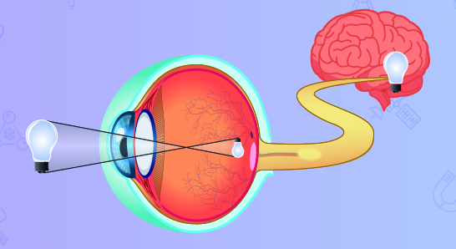
CHOOSE LIGHT RATHER THAN DARKNESS
Matthew 6:22,23

Slide 5
MASTER – SERVANT RELATIONSHIP
Romans 6:16
It is OUR CHOICE!

Slide 6
Sermon
on
the Mount
OUR MASTER GOD
HE MADE US
2 Samuel 22:4 “Lord, worthy to be praised”
Matthew 6:24 “serve” be in bondage; “master” God, Lord, Master; “mammon” Aramaic, riches
Word “MASTER” translated “LORD” in Revelation 22:6
Matthew 4:10 - God called LORD or MASTER
We will account to Him - Romans 14:12

Slide 7
Sermon
on
the Mount
OUR MASTER GOD
HE MADE US
Exodus 20:3 “no other gods before Me”
He is a jealous God – Exodus 34:14
GOD WILL PUNISH SPIRITUAL ADULTERERS
Leviticus 26:14-20
James 4:7 “submit to God – resist the devil”
Becoming a Christian is to become the slave of God, who is our Master

Slide 8
Sermon
on
the Mount
Initial Faith Leads To Repentance
My Master rules in my likes & dislikes
My Master rebukes me for sin
He calls me to obedience – be baptized
My submission to His will in ALL things
I agree to obey ALL that God requires
As His servant I will be what He wants me to be; go, serve, think and do as He wills
Mark 12:30 “Love the Lord (Master) your God

Slide 9
Sermon
on
the Mount
Matthew 6:24 ASV
24 “No man can serve two masters; for either he will hate the one, and love the other; or else he will hold to one, and despise the other. Ye cannot serve God and mammon.”
“be loyal to” NKJ “be devoted to” NASV
Greek Lit. “to line up face to face with one man and so against the other”
When we say we serve God we must be against Mammon

Slide 10
Sermon
on
the Mount
THE OTHER MASTER - MAMMON
“The other” – “…the other of two… i.e. one not of the same nature, form, class, kind, different”
Not simply the other of the two but the Master of distinct or opposite character
Riches & Treasure in which TRUST is placed
“Riches personified as a master – Gold, silver, riches, possessions are here intended.
“the World” often used to describe “worldly minded””

Slide 11
Sermon
on
the Mount
3 GREAT CHARACTERISTICS OF MAMMON
1. Riches can rule those who give their hearts to seek them
Deuteronomy 6:10-12
2. Riches are ruling our lives when they become the object of our affections
3. Some give up everything for this MAMMON:
1 Family
2 Credibility
3 The church

Slide 12
Sermon
on
the Mount
RETREAT FROM SERVING GOD
2 Corinthians 4:4 “whose minds the god of this age has blinded”
1 Timothy 6:9,10 “love of money is a root of all kinds of evil”
In the end Mammon destroys the LIFE & PERSONALITY of its servant – spirituality completely overshadowed by worldly affection

Slide 13
Sermon
on
the Mount
WE CANNOT SERVE BOTH
God demands single service -
Matthew 6:19 “do not lay up for yourselves treasures on earth…”
Matthew 6:22 “lamp of the body is the eye…”
To love God we must hate MAMMON!
Mammon is opposed to God – loving it pulls our love away from God
Therefore, we CANNOT SERVE BOTH!

Slide 14
Sermon
on
the Mount
SINCERITY OF HEART THE KEY
Colossians 3:22 “in sincerity of heart,…”
Matthew 6:19 “do not lay up for yourselves treasures on earth…”
God must always remain enthroned in our hearts
Matthew 6:33 “seek first the kingdom of God”
What happens when God is dethroned & Mammon enthroned?

Slide 15
Sermon
on
the Mount
WHEN MAMMON IS ENTHRONED
DEDICATION TO GOD IS WEAKENED
OUR GOALS IN LIFE ARE CHANGED
DIVISION OF COMMITMENT OCCURS
Matthew 16:24-26 “deny himself…take up his cross…follow Me”
Inconsistency becomes our “standard”
Eventually, God is totally rejected

Slide 16
LAST THREE LESSONS – ONE CENTRAL TRUTH
CHOOSE GOD
THE END WILL BE WORTH IT

